Slide 1




INNOVATIVE DATA VISUALISATION WITH AR/VR AND ETHERCALC SPREADSHEETS
TEAM MEMBERS
SAHIL WADHAWAN
KASHYAP CHANDRA PRATAP
ABHINAV SINGH
YASHITA SINGH
SHREYANSH AGARWAL
LOKENDRA SINGH
PS CATEGORY - SOFTWARE
TEAM NAME-ALPHA

Slide 2

Problem Statement
Innovating Data Visualization with AR/VR and EtherCalc Spreadsheets
Revolutionizing Spreadsheets: Experience Data Like Never Before
Spreadsheets are essential tools, but they often feel overwhelming and static. Imagine transforming those flat grids into a dynamic 3D environment where data comes to life. With our AR/VR solution, we're not just visualizing data—we're immersing you in it. This is the future of data interaction, making complex information more intuitive, engaging, and impactful.

Slide 3

Proposed Solution
Revolutionary 3D Data Visualization
Transform traditional charts into immersive 3D experiences:
Bar Charts
Scatter Plots
Network Graphs
Interactive Exploration
Engage with data like never before:
Manipulate data points and filters in real-time
Discover insights with intuitive interactions
Enhanced Engagement
Immerse yourself in data analysis with an interactive and visually captivating experience.
Benefits
Deeper Data Insights: 3D visualizations bring patterns and trends to life, making them easier to understand.
Boosted Engagement: Interactive experiences capture attention and improve focus during analysis.
Seamless Collaboration: Real-time multi-user interaction fosters teamwork and enhances decision-making.
Wider Accessibility: User-friendly design ensures that people of all data expertise levels can participate.
Future-Proof Innovation: Stay ahead with cutting-edge data technology that positions you as a leader in your field

Slide 4
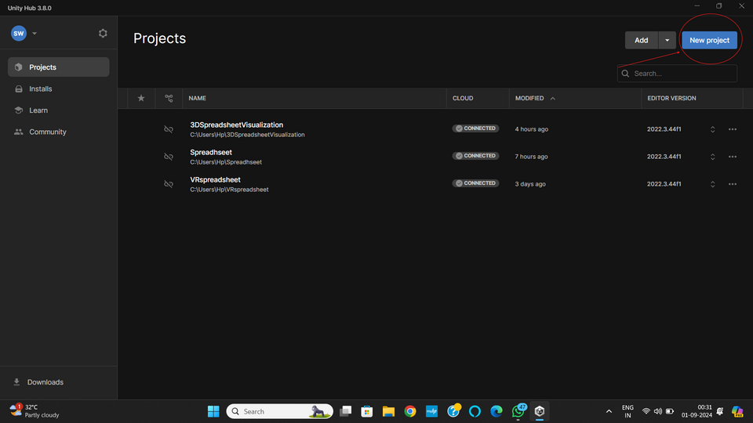
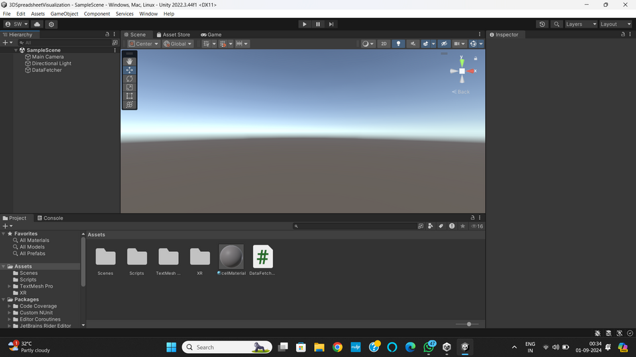
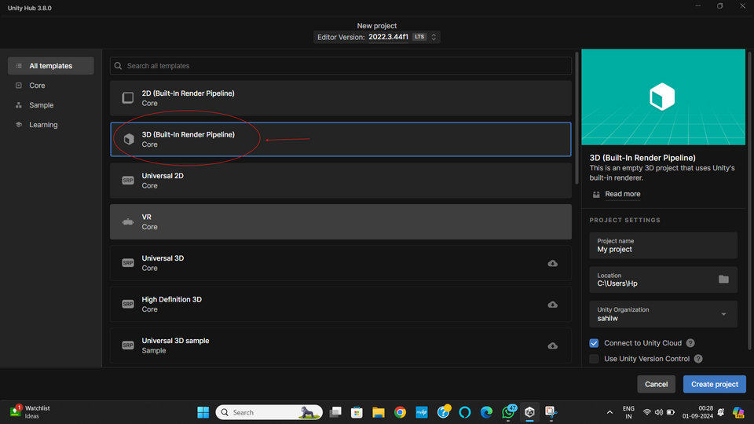
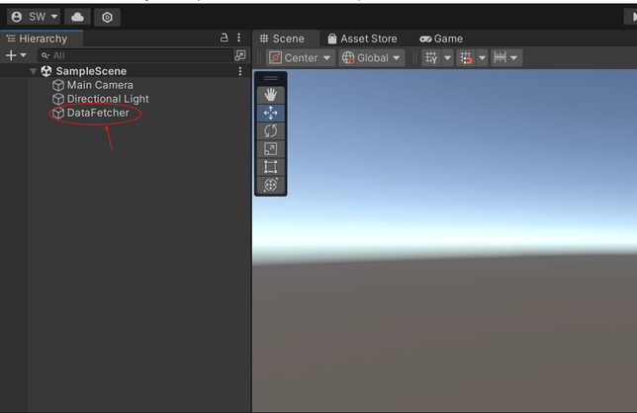
Process to Create AR Spreadhseet using Unity Hub:
Launch Unity Hub and click on the "New Project" button.
3. Work Area and Sample Scene
2. Choose the 3D template to work in a three-dimensional environment.
4. Add a 3D Object

Slide 5
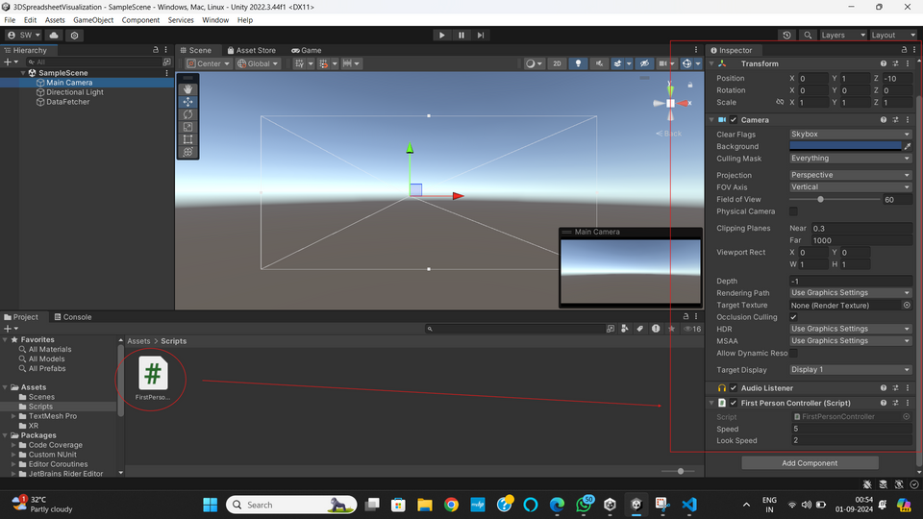
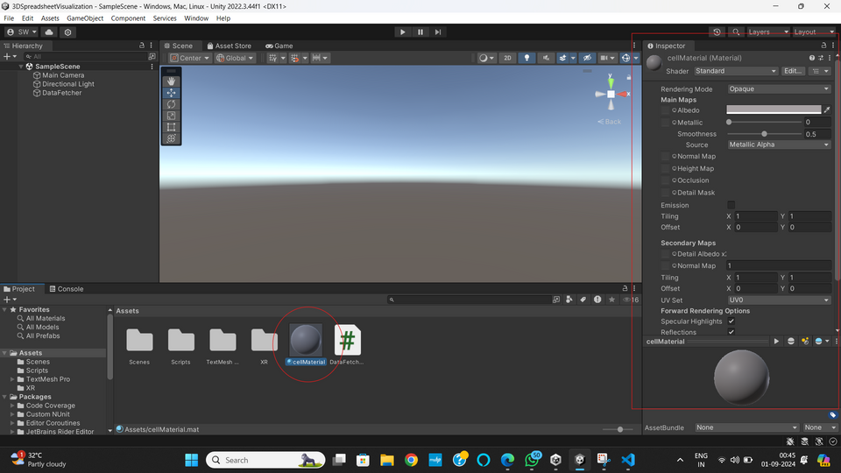
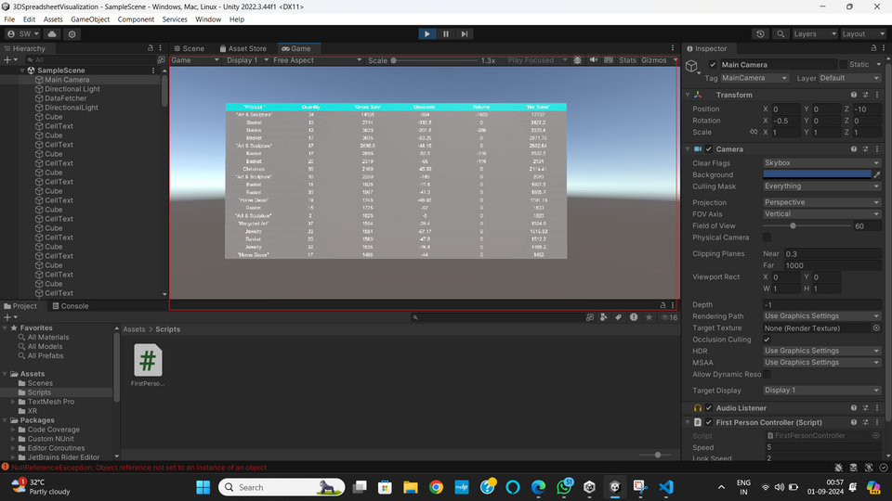
5. Add a DataFetcher C# Script to the Assests Folder
Code: https://drive.google.com/file/d/1vNWWactuoL52EH02hopocHnNVRlheppu/view?usp=sharing
Explaination of the code: https://drive.google.com/file/d/1tHNm4b7BgTqLLIFx46EzNYfj1QgOhmYT/view?usp=sharing
EtherCalc Spreadsheet link: https://ethercalc.net/h29023k3e0
7. Drag and drop the FirstPersonController Script to the Main Camera element in the hierarchy and set the values for "Speed" and "Look Speed"
6. Create a cellMaterial element for the Cells of the table and add it to the DataFetcher object
Code: https://drive.google.com/file/d/1ZPhPqqQNrS5F8En-o-I_4RpHCoIi9fbh/view?usp=sharing
8. Build and Run the Project

Slide 6
Tech Stack
The tech stack and libraries used in this project include:
Frontend/Visualization:
Unity: A powerful game engine used for creating 3D and 2D games, simulations, and visualizations. Unity is utilized here to create a 3D table that visualizes spreadsheet data fetched from EtherCalc.
Programming Language:
C#: The primary programming language used in Unity for scripting the behavior of objects, such as fetching and parsing data, creating 3D objects, and managing the camera and lighting.
Web/API Integration:
UnityWebRequest: A Unity library used to send HTTP requests to fetch data from web services. In this case, it's used to fetch CSV data from an EtherCalc URL.
Data Parsing:
String Manipulation: Basic string functions like Split are used to parse CSV data into a format that can be visualized as a 3D table in Unity.
3D Object Creation:
PrimitiveType.Cube: Unity's primitive type is used to create the 3D cells that represent the spreadsheet data.
TextMesh: A Unity component that allows for rendering text in 3D space, used to display the cell contents.
UI/UX:
Camera and Lighting Setup: Custom configurations for camera positioning and lighting to ensure that the 3D table is well-lit and visible from the correct angle.

Slide 7

ENHANCED DATA UNDERSTANDING
Our solution allows users to explore complex datasets in a 3D environment, making it easier to identify patterns, trends, and insights that are often missed in traditional 2D spreadsheets.
Increased Engagement
By transforming data analysis into an immersive experience, users are more engaged with their data, leading to better decisions and more informed outcomes.
Business Model
Future-Ready Analytics
As data-driven decision-making becomes increasingly important, our solution positions users at the forefront of technological innovation, giving them a competitive edge in today’s data-centric landscape
Broadened Accessibility
The intuitive interface makes it easy for users with limited data expertise to interact with and understand complex information, making it ideal for educational purposes and diverse teams.

Slide 8
Challenges Faced
Challenge: Data Fetching and Parsing
Solution: Leveraged UnityWebRequest for seamless data integration and utilized advanced string manipulation techniques for accurate parsing.
Challenge: 3D Visualization and Layout
Solution: Applied precise calculations for cell scaling and positioning, ensuring smooth and accurate 3D visualizations.
Challenge: Text Readability and Alignment
Solution: Optimized TextMesh properties for clear, readable text and perfect alignment within the 3D space.
Challenge: Camera and Lighting Configuration
Solution: Fine-tuned camera angles and lighting setups to enhance visibility and create the perfect visual balance.
Challenge: Performance Management
Solution: Implemented strategic optimizations to efficiently handle large datasets without compromising performance.

Slide 9
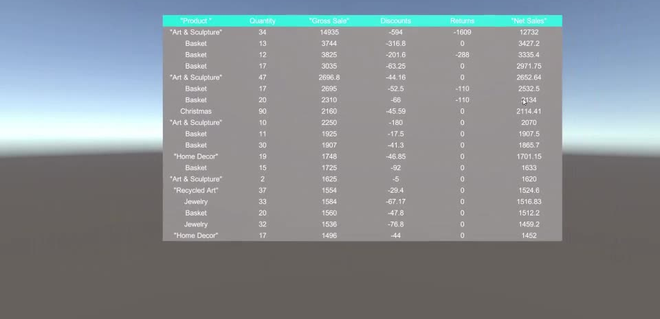
PROTOTYPE

